Slide 1

SDEV 1701
Introduction to Low-Fidelity Prototypes and Wireframes

Slide 2
UNDERSTANDING EARLY-STAGE DESIGN IN UXUI

Slide 3
WIREFRAMES VS. PROTOTYPES
Turning any innovative idea into a tangible product requires a crucial first step: creating a wireframe. These basic mockups, either hand-drawn or designed in software, allow you to test concepts long before a single line of code is written.
Think of any app or website that changed the world - each one started with a low-fidelity wireframe.

Slide 4

WIREFRAMES VS. PROTOTYPES
Wireframe: Static, low-fidelity structure of UI screens
Prototype: Interactive simulation of the end product
Both help define structure, flow, and functionality early in the process

Slide 5
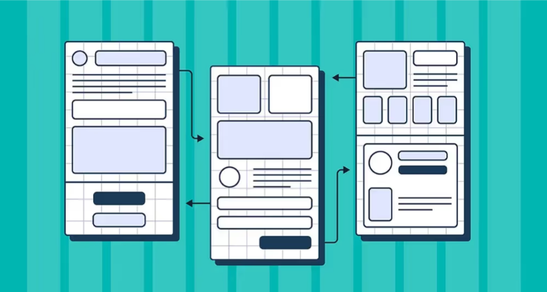
WHAT IS A WIREFRAME?
A wireframe is the foundation of successful UX design. It is a basic drawing that reflects the structure and main functions of a web page or app screen. It is most often monochrome and consists of simple geometric shapes and lines that indicate the location of key navigation elements, text, and graphics. As the design concept develops, wireframes gradually become more detailed.

Slide 6
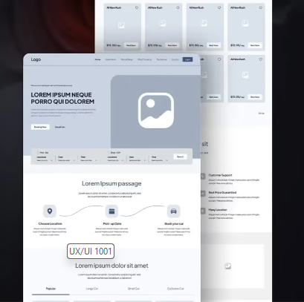
WHAT IS A WIREFRAME?
These rough sketches, whether digital or hand-drawn, are powerful ideation tools . They help teams iterate quickly and work more collaboratively, resulting in a more streamlined and efficient workflow. The benefits of wireframing are undeniable: research shows that they can reduce overall design time by up to 50%.

Slide 7
What is detailing?
Detail is the degree to which a wireframe resembles the final product. There are three key aspects that determine the level of detail:
How accurately does the wireframe layout reflect the final product layout?
How detailed and complete is the content (text, images, etc.)?
Does the wireframe include interactive elements, and to what extent does it mimic the behaviour of the final product?

Slide 8
types of wireframes
Low Fidelity Wireframes: Quick, rough sketches of the product structure and interface elements. Focus on core functionality and user scenarios.
Mid-Fidelity Wireframes: Slightly more detailed sketches that contain more visual and functional elements.
High Fidelity Wireframes: Detailed, interactive mockups that closely resemble the final product, both visually and functionally. Also called “prototypes.”

Slide 9
USING LOW-FIDELITY WIREFRAMES

Slide 10
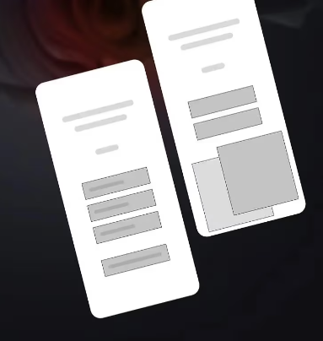
low-fidelity wireframes
A lo-fi wireframe is the starting point of your design. It prioritizes key concepts and value propositions, leaving behind complex visual details like images and edited text.
Here's what makes lo-fi wireframes special:
Basic shapes, lines and placeholders are used to present content.
Ideal for demonstrating the fundamental structure of an interface.
Created early in the design process, after initial brainstorming and concept development.

Slide 11
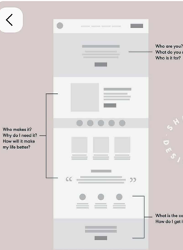
low-fidelity wireframes
Low-fidelity wireframes can be quickly sketched out on paper or created in minutes using simple digital tools (e.g. Balsamiq , InVision , Figma ).
This makes them ideal for quickly testing design ideas.

Slide 12
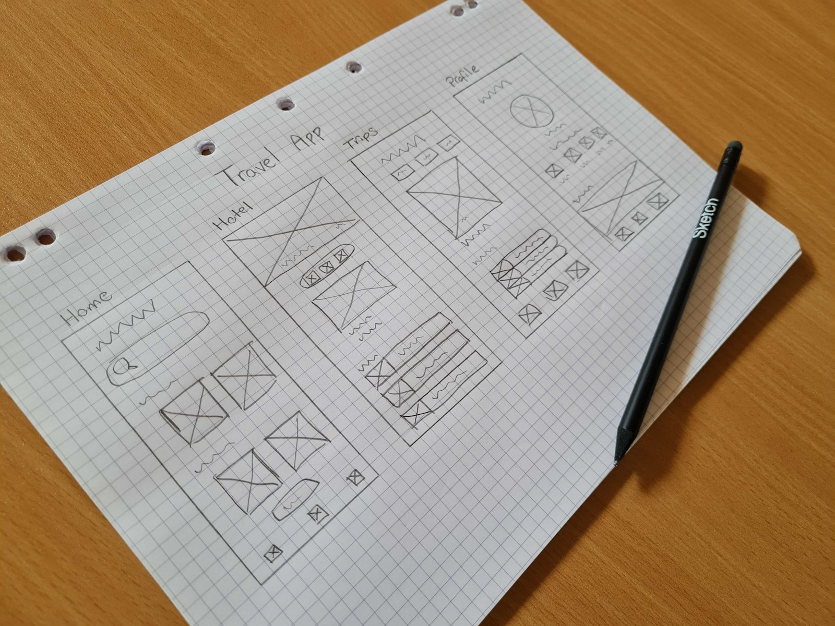
What are benefits of low-fidelity wireframes
Valuable feedback
Simplicity encourages stakeholders and users to focus on functionality and usability rather than aesthetics. The result is truly useful insights that enhance the final product.

Slide 13
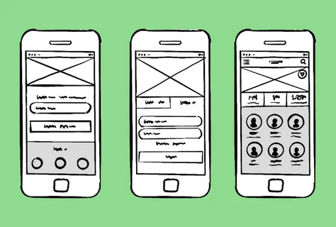
What are benefits of low-fidelity wireframes
Flexible workflow (agile)
Designers can make changes quickly by experimenting with different ideas and solutions. This helps create products that meet user needs.

Slide 14
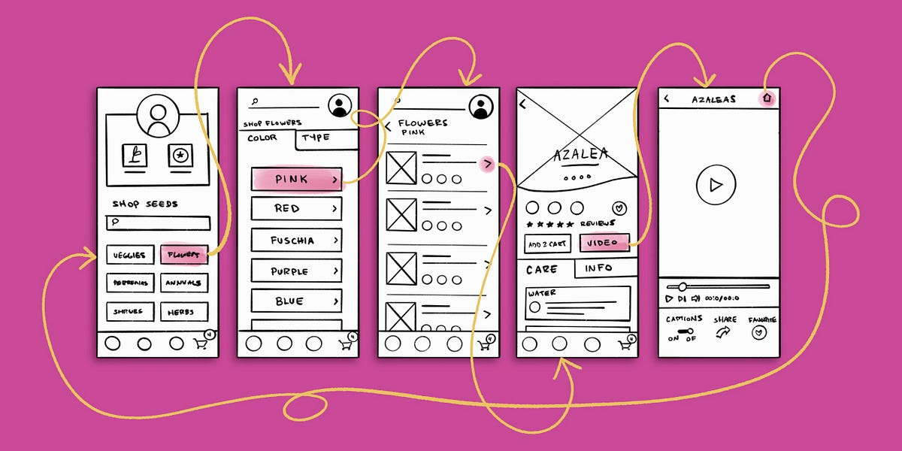
What are benefits of low-fidelity wireframes
Saving time and resources
Early identification and resolution of potential problems saves time and resources later in the design process.

Slide 15
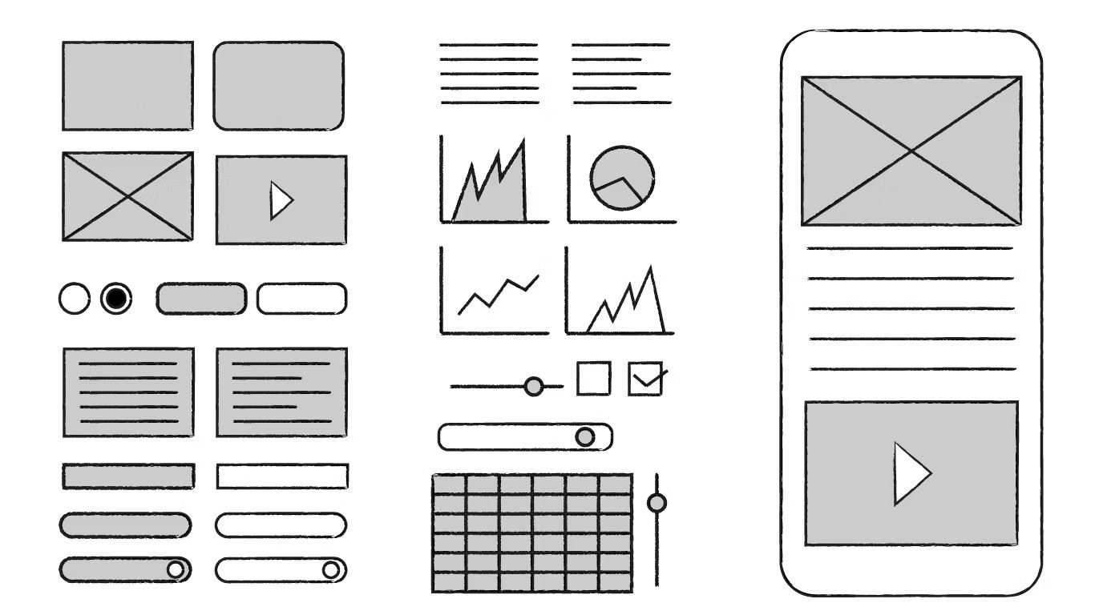
What are benefits of low-fidelity wireframes
Effective communication
Low-fidelity wireframes bridge the communication gap between designers, developers, and stakeholders. They make layouts and user flows simple and understandable for everyone.

Slide 16
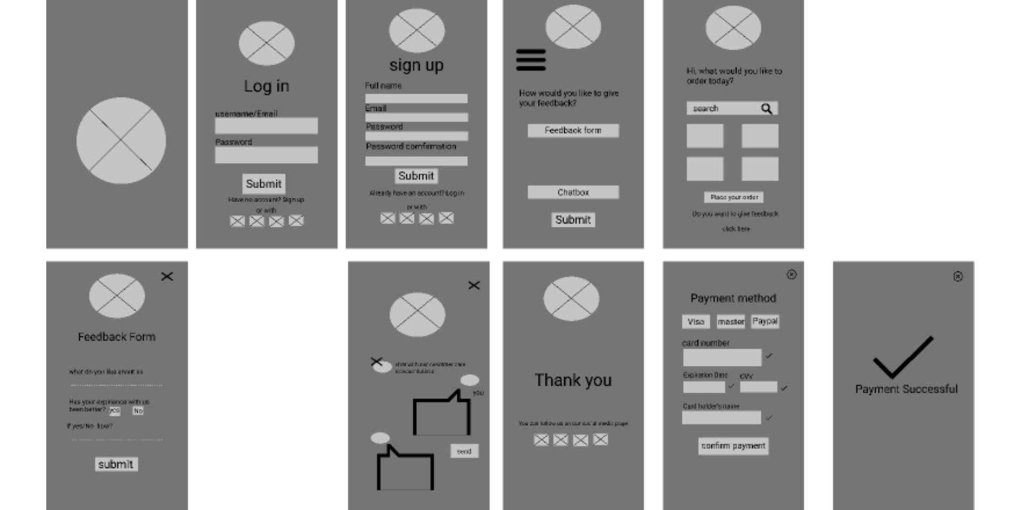
What are benefits of low-fidelity wireframes
Checking design and functionality
Wireframes help you test design ideas, features, and interactions and get client approval before diving into the details.
Approved wireframes serve as a roadmap for further design.

Slide 17
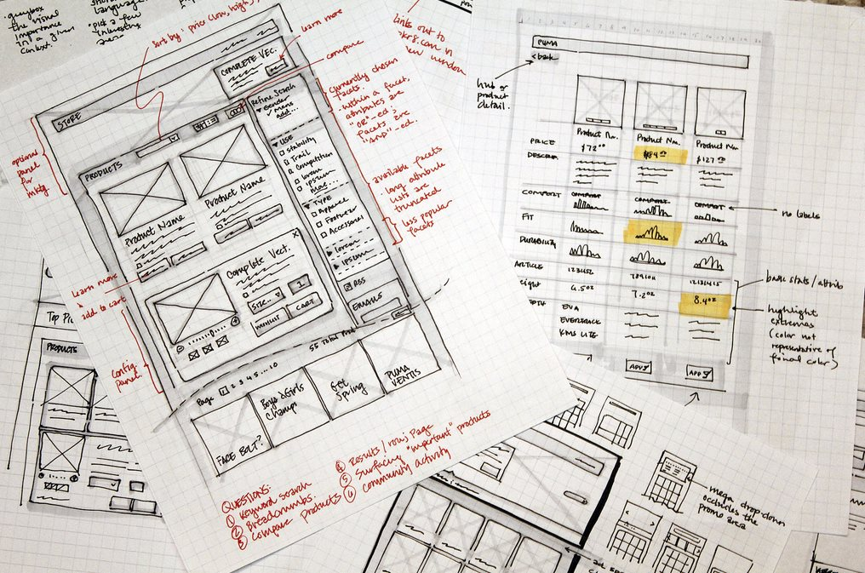
What are benefits of low-fidelity wireframes
Visualization of user scenarios
Low-fidelity wireframes focus on UX and help create user-centred designs. They are based on insights gathered through research.

Slide 18
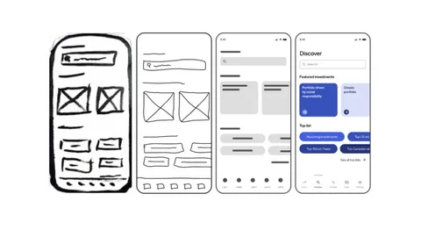
Purpose of LO-FI Wireframes
Communicate layout and structure
Align teams around page structure
Plan user navigation and interaction flow
Save time before high-fidelity work

Slide 19
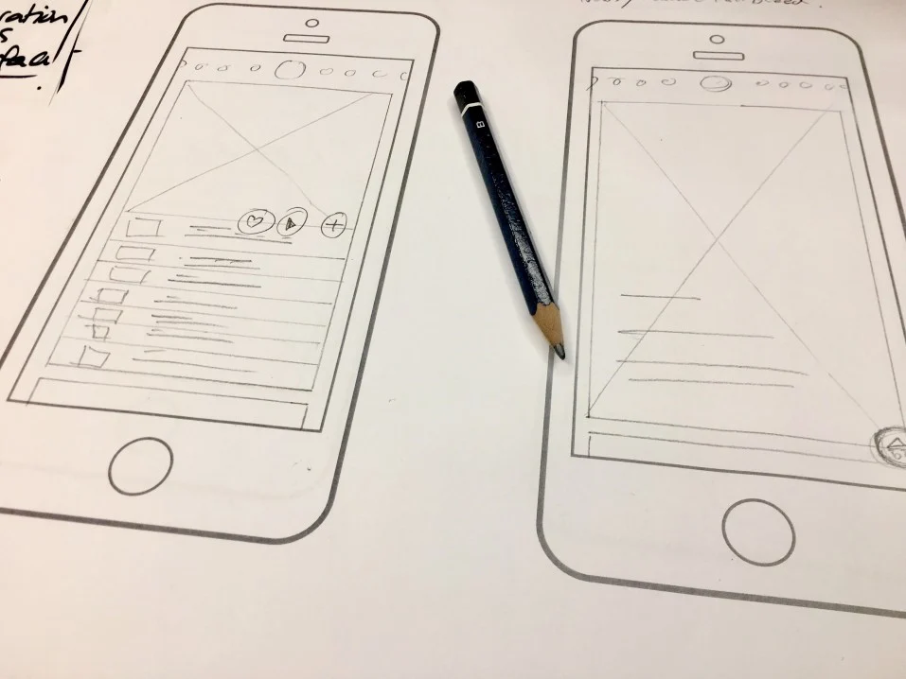
When to Use Wireframes
Early in the design process
After research and ideation
Before any visual styling
During user journey mapping or task flow exploration

Slide 20

Benefits of Wireframes
Fast to produce and edit
Encourages feedback and iteration
Helps focus on functionality
Acts as documentation for developers

Slide 21
Disadvantages of Low-Detail Wireframes
While low-fidelity wireframes have many benefits, they also come with certain limitations. One of them is simplicity.
The lack of detail makes it difficult for team members and stakeholders to fully understand what the user experience will be like.
Without visual cues and interactive elements, they cannot accurately envision the final product.

Slide 22
Disadvantages of Low-Detail Wireframes
Lack of Visual Appeal: When functionality is prioritized over aesthetics, it becomes more difficult to attract stakeholders and users.
Lack of interactivity: Static wireframes do not allow interaction with the interface, making it difficult to test user scenarios.
Potential for miscommunication: Overly simplified wireframes can be confusing to team members and stakeholders, especially if the latter are not familiar with the principles behind their construction.
Limited use later in the workflow: Lo-fi wireframes are great for the early stages of design, but as you move forward, the need for more detailed, high-fidelity prototypes arises.

Slide 23
WIREFRAME EXAMPLES

Slide 24
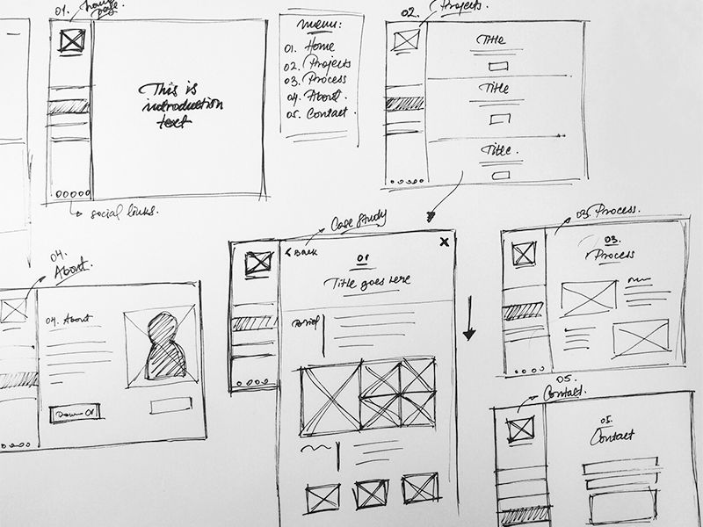
HAND DRAWN LO-FI WIREFRAME (BASIC)
This quick sketch is low-detail. There is no text, no images, no colors. By drawing 3-4 main sections or pages, we can instantly get an idea of ​​the main functions of the site or application.
Despite their simplicity, they effectively show the main stages of the user journey, allowing you to collect feedback and make edits before fully immersing yourself in the details.

Slide 25
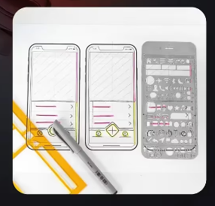
HAND DRAWN LO-FI WIREFRAME (ADVANCED)
Despite being a lo-fi wireframe , it clearly shows the structure of the app and its main functions. We see specific sections - Popular, Search, Your Tickets, Profile, Friends.
The UI elements inside each section (buttons, navigation bars, content areas) are outlined with basic shapes and lines. A perfect basis for creating a user-oriented design.

Slide 26

RESPONSIVE LO-FI WIREFRAME
A responsive wireframe is a basic visual representation of how an interface adapts to different screen sizes. It allows you to understand how the design will look on different devices - desktop, tablet, and mobile.
Responsive, low-fidelity wireframes bridge the gap between design and development teams. They enable clear communication and minimize misunderstandings. Developers quickly gain a basic understanding of the intended structure and functionality of the product on various devices.
One of the best practices when creating such wireframes is the “mobile first” approach (always start designing from the mobile version of the site). Given the dominant position of mobile devices in the market, focusing on such interfaces allows for more effective placement of content on small screens and aligning the design with the needs and behaviour of users.

Slide 27
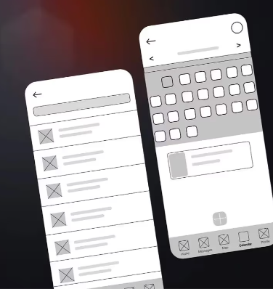
LO-FI WIREFRAMES FOR MOBILE APPS
Such wireframes display the layout and functionality of a mobile application. The main UI elements — buttons, navigation panels, and content areas — are designated by basic geometric shapes.
Despite the lack of details and text, the wireframe clearly shows the structure of the future product. It is a great starting point that allows you to refine the concept and correct errors before diving deeper into the design.

Slide 28
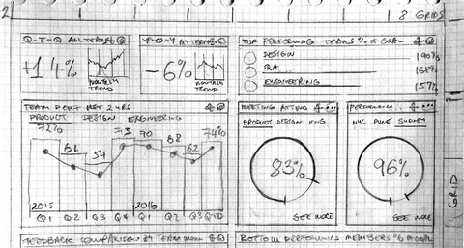
BEST PRACTICES FOR WIREFRAMES
Avoid pixel-perfection
Use annotations to explain actions
Focus only on essential elements
Highlight clickable areas
Get feedback early and often

Slide 29

TOOLS FOR WIREFRAMING
Paper + Pen: Best for fast iteration
Balsamiq: Digital sketch style
Figma/InVision: Free & collaborative
Adobe XD: Easily transform wireframes into prototypes

Slide 30
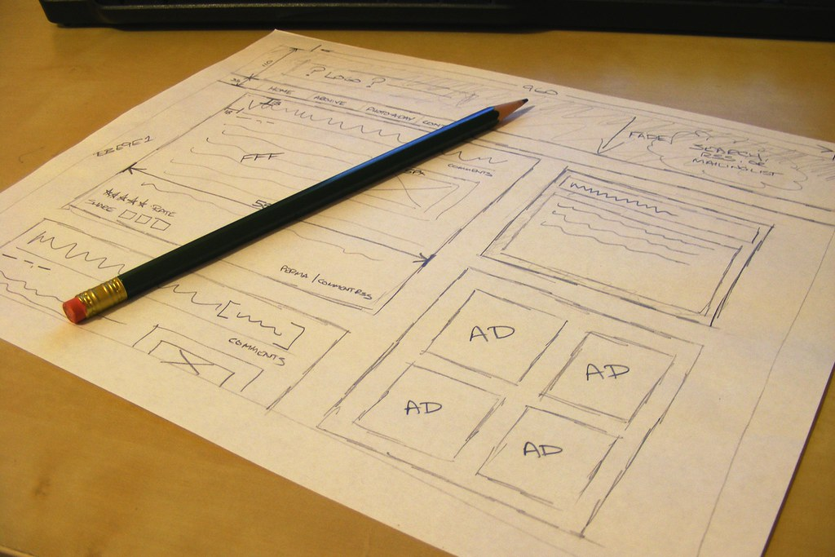
How to Create a Low-Detail Wireframe
The beauty of low-fi wireframes is their accessibility. Each of us can quickly make a few sketches without having any special tools at hand.

Slide 31
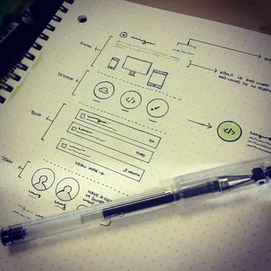
How to Create a Low-Detail Wireframe
Grab a pen and paper: That's all you need to bring your design ideas to life.

Slide 32
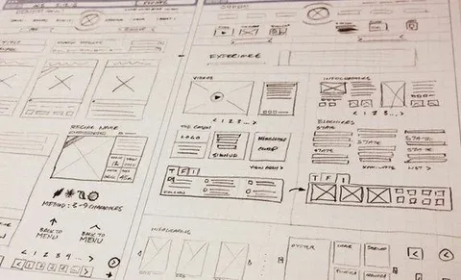
How to Create a Low-Detail Wireframe
Sketch out the layout: Start with the basic structure of a web page or app screen. Use basic shapes — squares, rectangles, circles, and lines — to outline key elements. Our goal is to show the main features and user scenarios.

Slide 33
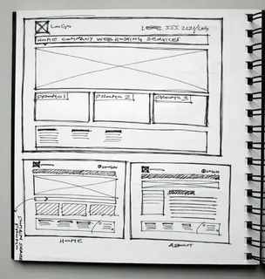
How to Create a Low-Detail Wireframe
Add placeholders for text and images - simple text labels and basic shapes.

Slide 34
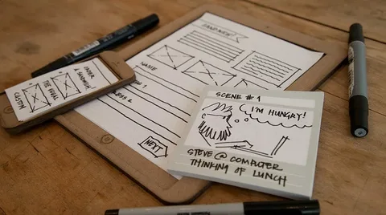
How to Create a Low-Detail Wireframe
Refine and iterate: Use your lo-fi wireframe to test and refine ideas.
Present it to stakeholders and users to get valuable feedback and make adjustments as needed.

Slide 35
Summary and Reflection

Slide 36
REFLECTION PROMPT
What makes a low-fidelity wireframe effective?
How can you use lo-fi wireframes in your next project?

Slide 37
Homework:
Low-Fi Prototype:
Task: Create a low-fi prototype for a common UX problem (e.g., a checkout page).
Practice: Create a hand-drawn wireframe for a basic app

